Slide 1
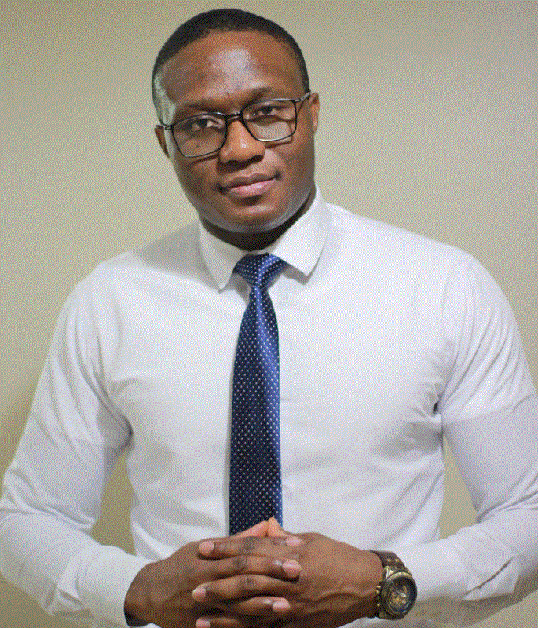
Albert Eromosele
TECHNICAL SUPPORT ENGINEER

Slide 2
Powershell For Administrators
Albert Eromosele
TECHNICAL SUPPORT ENGINEER

Slide 3


MAINTENANCE
TROUBLESHOOT

Slide 4
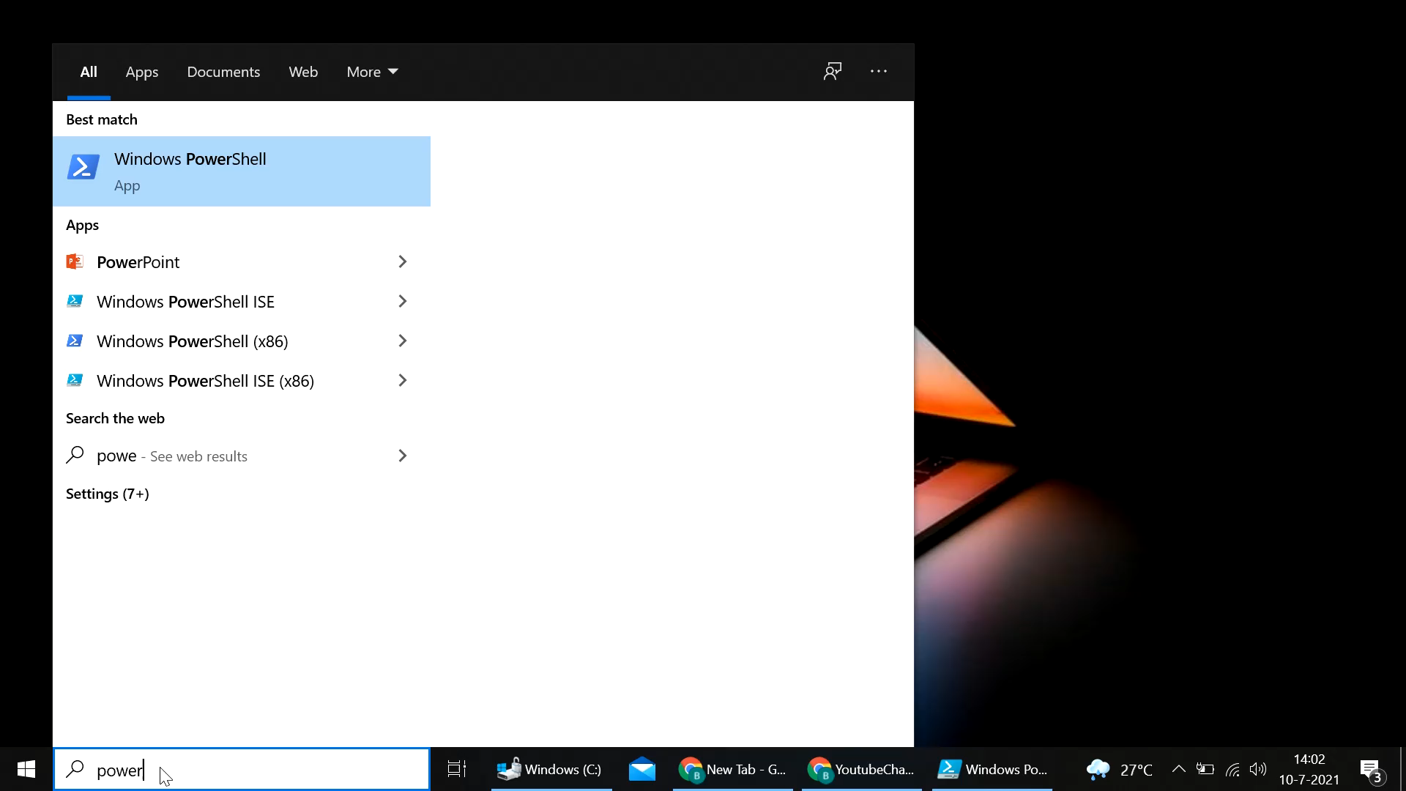
POWERSHELL

Slide 5
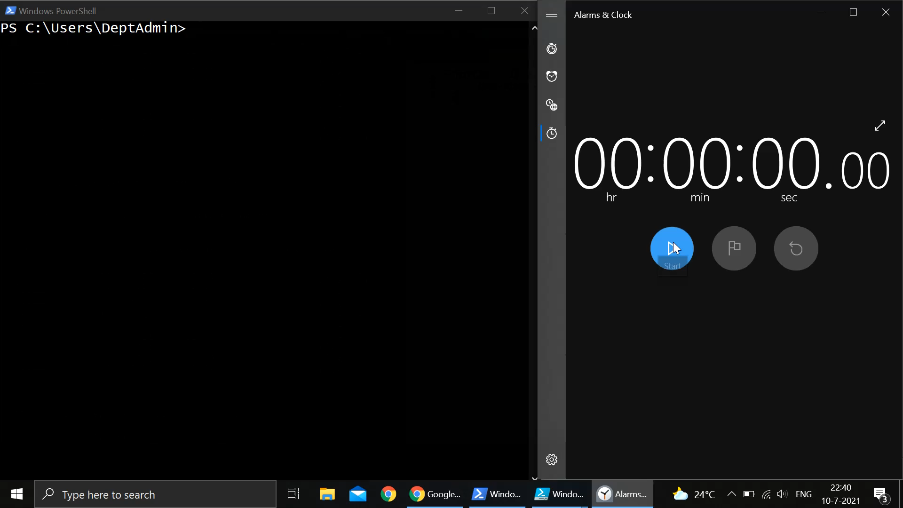
POWERSHELL

Slide 6
MAINTENANCE
TROUBLESHOOT

Slide 7
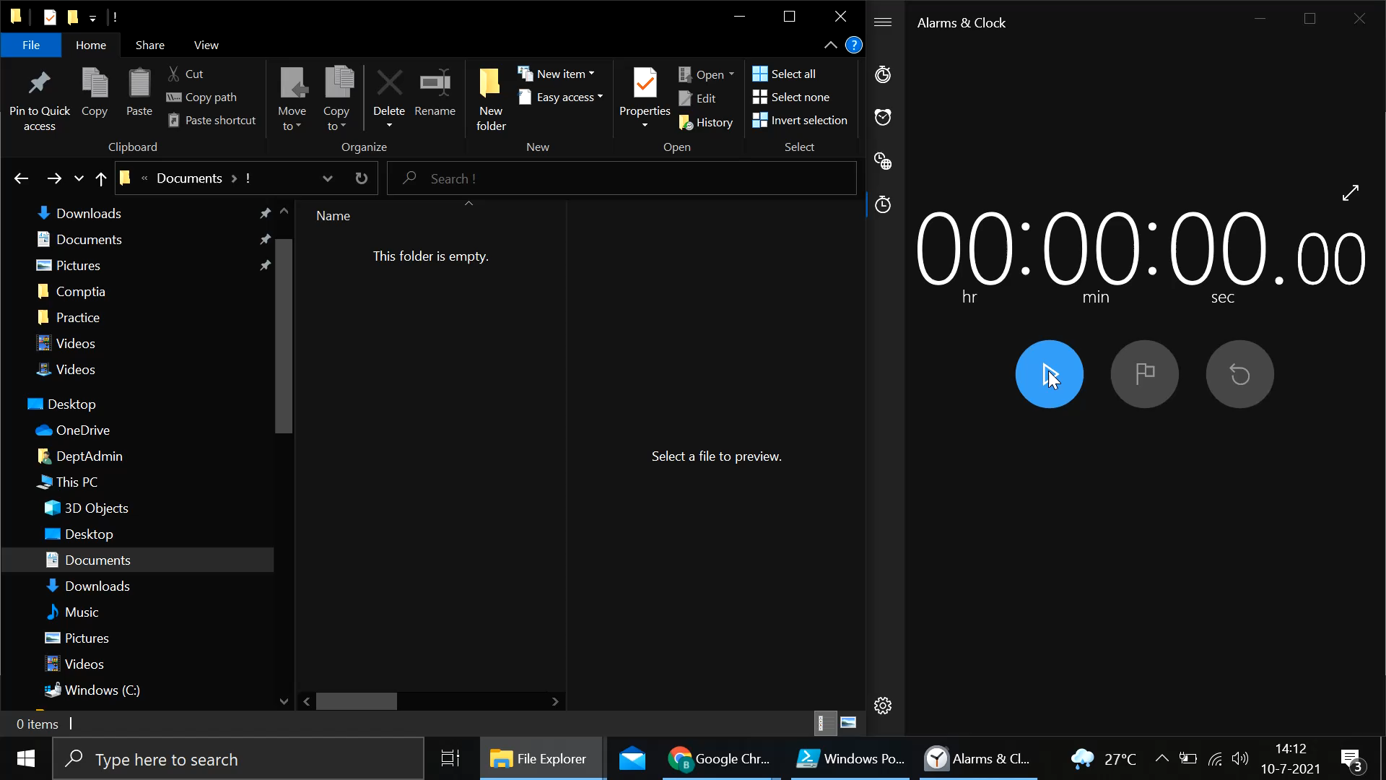

Slide 8
Albert Eromosele
IT SUPPORT TECH

Slide 9
